Slide 1




ENROLMENT & DEDICATION 2 OCTOBER 2020
20th Anniversary

Slide 2
MOTTO of Boys’ Brigade
SURE & STEDFAST
OBJECT of Boys’ Brigade
The advancement of Christ's kingdom among Boys and the promotion of habits of Obedience, Reverence, Discipline, Self-respect and all that tends towards a true Christian manliness.

Slide 3
Girls' Brigade MOTTO
SEEK, SERVE & FOLLOW CHRIST
Girls' Brigade AIM
To help girls to become followers of the Lord Jesus Christ and through self-control, reverence and a sense of responsibility to find true enrichment of life.

Slide 4
PRAYER FOR BRIGADES (1/2)
Dear Lord, we praise and thank You for the 47th Company of The Boys’ Brigade and the 55th Company of The Girls’ Brigade based in Serangoon Garden Secondary School.
We thank You for the support and encouragement of the Ministry of Education, the Principal, Senior Management, Teachers and Staff of the school, parents and friends of all the young women and young men, all those who have “graduated” but continue to return to help in one way or another, and all volunteers from the church and elsewhere.

Slide 5
PRAYER FOR BRIGADES (2/2)
Today, as we join with them in their Annual Enrolment and Dedication, we pray that the members of both brigades, and their NCOs, Officers, Teachers and Volunteers – will always remain Sure & Stedfast even as they continually Seek, Serve, and Follow Christ.
May we, as Your Church, find ways to come-alongside both brigades to assist and to enable them to attain excellence.
We pray and ask all these in Your Name, and for Your sake Lord Jesus, Captain Divine, AMEN.

Slide 6
SCRIPTURE (1/3)
Ecclesiastes 12:1, 9-14 (ESV)
¹Remember also your Creator in the days of your youth, before the evil days come and the years draw near of which you will say, “I have no pleasure in them”;
⁹Besides being wise, the Preacher also taught the people knowledge, weighing and studying and arranging many proverbs with great care. ¹⁰The Preacher sought to find words of delight, and uprightly he wrote words of truth.

Slide 7
SCRIPTURE (2/3)
Ecclesiastes 12:1, 9-14 (ESV)
¹¹The words of the wise are like goads, and like nails firmly fixed are the collected sayings; they are given by one Shepherd. ¹²My son, beware of anything beyond these. Of making many books there is no end, and much study is a weariness of the flesh.
¹³The end of the matter; all has been heard. Fear God and keep His commandments, for this is the whole duty of man. ¹⁴ For God will bring every deed into judgment, with every secret thing, whether good or evil.

Slide 8
SCRIPTURE (3/3)
1 Timothy 4:11-16 (ESV)
¹¹Command and teach these things. ¹²Let no one despise you for your youth, but set the believers an example in speech, in conduct, in love, in faith, in purity. ¹³Until I come, devote yourself to the public reading of Scripture, to exhortation, to teaching. ¹⁴Do not neglect the gift you have, which was given you by prophecy when the council of elders laid their hands on you. ¹⁵Practice these things, immerse yourself in them, so that all may see your progress. ¹⁶Keep a close watch on yourself and on the teaching. Persist in this, for by so doing you will save both yourself and your hearers.

Slide 9
DEDICATION & ENROLMENT RITUAL

Slide 10
Dedication of Officers & Officer-Cadets
CHAPLAIN: Do you undertake to serve God faithfully as Officers of The Boys’ Brigade 47th Singapore Company and The Girls’ Brigade 55th Singapore Company?
OFFICERS: Realizing the responsibilities involved in our leadership as Officers, we pledge ourselves to serve God in furthering the Object of The Boys’ Brigade and the Aim of The Girls’ Brigade.
CHAPLAIN: May God grant you grace to be faithful in your trust, and crown your work with success. AMEN.

Slide 11
Dedication of Non-Commissioned Officers (NCOs)
CHAPLAIN: NCOs of 47th BB Company & 55th GB Company, do you promise to carry out your duties with diligence and passion?
NCOs: Having been appointed to this rank and as a member of The Boys’ Brigade 47th Singapore Company and The Girls’ Brigade 55th Singapore Company, I promise, God helping me, to support my Officers loyally, to carry out my duties in a cheerful and faithful manner, and at all times to set an example to the boys and girls in my company.
CHAPLAIN: May God grant you grace to put service for others above all else, for the advancement of Christ’s Kingdom among the Boys and Girls. AMEN.

Slide 12
Dedication of Members
CHAPLAIN: Members of 47th BB Company & 55th GB Company, do you promise to support and listen to your Officers, Teachers, and NCOs, and to participate fully in all activities of your brigade with passion and diligence?
MEMBERS: As Members of The Boys’ Brigade 47th Singapore Company and The Girls’ Brigade 55th Singapore Company, we promise, God helping us, to support our Officers, Teachers, & NCOs so that they can carry out their duties in a cheerful and faithful manner, and at all times determine to be exemplary in our conduct at home to our families and in school to our schoolmates.
CHAPLAIN: May God grant you all His favour and grace, and the strength and resoluteness to cultivate habits of Obedience, Reverence, Discipline, Self-Respect, Self-Control, and Sense of Responsibility. Amen.

Slide 13
ENROLMENT OF RECRUITS (New Members) [1/2]
47th BB Captain to BB Chaplain: Sir, I present these RECRUITS, who desire to be enrolled as Members of The Boys’ Brigade 47th Singapore Company.
55th GB Captain to GB Chaplain: Sir, I present these RECRUITS, who desire to be enrolled as Members of The Girls’ Brigade 55th Singapore Company.
CHAPLAIN to RECRUITS: Young Men & Young Ladies, desiring to be enrolled as Members of The Boys’ Brigade 47th Singapore Company and The Girls’ Brigade 55th Singapore Company, do you promise to obey the rules of the Company, and to set an example of good conduct to your friends and other Boys & Girls?
RECRUITS: I DO.

Slide 14
ENROLMENT OF RECRUITS (New Members) [2/2]
CHAPLAIN to Recruits: May Jesus Christ give you strength to be faithful to duty, loyal to your friends, strong in times of temptation and be His faithful servants always.
CHAPLAIN to REPRESENTATIVES of Trinity Methodist Church (TMC): Finally I have a question to put to the representatives
<a> Do you promise to support the work being done by The Boys’ Brigade 47th Singapore Company and to pray for the Boys and Officers that God will keep them Sure and Stedfast in their faith?
<b> Do you promise to support the work being done by The Girls Brigade 55th Singapore Company, and to pray for the Girls and Officers that God will guide them always to Seek, Serve, and Follow Christ?
REPRESENTATIVES: WE DO.

Slide 15
BOYS’ BRIGADE (1/4)
(NCOs Sec 4)
SSG | Alvin Leong Jun Kit | Sec 4
SSG | Arun Rahul | Sec 4
SSG | Isaac Lim Zi Yuan | Sec 4
SSG | Lee Teck Kang | Sec 4
SSG | Lim Bing Yi Schuyler | Sec 4
SSG | Ow Kia Chuan | Sec 4
SSG | Toh Kheng Seng Jayden | Sec 4
SGT | Lennon Lim Jia Le | Sec 4
SGT | Ravi Raphael Mariano | Sec 4
SGT | Siddharth Singh | Sec 4
CPL | Chiao Jun Ming | Sec 4
CPL | Heng Darius | Sec 4
CPL | Ho Yuan Heng Jabian | Sec 4
CPL | Irick Zlaton | Sec 4
CPL | Jordon Tham | Sec 4

Slide 16
BOYS’ BRIGADE (2/4)
(NCOs Sec 3)
SGT | Braden Phua Chai Ee | Sec 3
SGT | Bryan Teo Wen Ming | Sec 3
SGT | Loh Ee Gene, Gabriel | Sec 3
SGT | Low Zi Tian | Sec 3
SGT | Wayne Yeo | Sec 3
CPL | Ang Shao En | Sec 3
CPL | Bin Jin Ming Joseph | Sec 3
CPL | Brendon Kwok Zhong Xun | Sec 3
CPL | Harish Aehesu | Sec 3
CPL | Hoi Hin Lun Darren | Sec 3
CPL | Tyrel Zechariah Lim Rui Hong | Sec 3

Slide 17
BOYS’ BRIGADE (3/4)
(NCOs Sec 2)
LCP | Alfonsus Si Yong Sheng | Sec 2
LCP | Brandon Lim Jun Wei | Sec 2
LCP | Chong Wen Cong, Andy | Sec 2
LCP | Chua Wen Hung Gary | Sec 2
LCP | Josh Yeo Dingxuan | Sec 2
LCP | Li Fengyu | Sec 2
LCP | Lim Jun Yi Gavin | Sec 2
LCP | Ong Kai Xi | Sec 2
LCP | Wong Yuan Le | Sec 2
LCP | Zheng Libin | Sec 2

Slide 18
BOYS’ BRIGADE (4/4)
(RECRUITS Sec 1)
PTE | Bak Jin Cheng | Sec 1
PTE | Boo Jian Hao | Sec 1
PTE | Ethan Kwan Hong Wei | Sec 1
PTE | Goh Xuan Cheng | Sec 1
PTE | Janakiraman Nitish Kumar | Sec 1
PTE | Jayvil Choo | Sec 1
PTE | Lau Liang Feng Isaac | Sec 1
PTE | Lim Jian Da Javier | Sec 1
PTE | Lim Teng Song Wallace | Sec 1
PTE | Loh Wai Tong | Sec 1
PTE | Matthew Teo Tian Rui | Sec 1
PTE | Miao Jianan | Sec 1
PTE | Peh Jun Liang Jordon | Sec 1
PTE | Quek Boon Cheng, Brendan | Sec 1
PTE | Ryan Toh Boon Chong | Sec 1
PTE | Seth Kua | Sec 1
PTE | Tan Yi Jay, Zayne | Sec 1

Slide 19
GIRLS’ BRIGADE (1/4)
(NCOs Sec 4-5)
SSGT | Dhiman Diksha | Sec 5
SSGT | Leow Li Ping Alicia | Sec 4
SSGT | Tiffany Kiew Hwee | Sec 4
SGT | Chew Xin Rui Cheryl | Sec 4
SGT | Leaw Sze Hearn, Rene | Sec 4
SGT | Rachel Cheong Jing Ying | Sec 4
SGT | Tan Pei Tong | Sec 4
CPL | Zennerein Loo En Xuan | Sec 4
CPL | Hriya Kaur | Sec 4

Slide 20
GIRLS’ BRIGADE (2/4)
(NCOs Sec 3)
CPL | Charlotte Siao Xiu Qin | Sec 3
CPL | Rodriguez Kristiana Danielle Nuelan | Sec 3
CPL | Nikitha Saravanabava | Sec 3

Slide 21
GIRLS’ BRIGADE (3/4)
(NCOs Sec 2)
LCP | Armoor Riddhi Reddy | Sec 2
LCP | Ching Zi Ying Fion | Sec 2
LCP | Chloe Ng Sze Hwee | Sec 2
LCP | Georgia Ng Xuan En | Sec 2
LCP | Jeraldine Goh Le Qi | Sec 2
LCP | Kok Yi Ching | Sec 2
LCP | Lee Jia Wei | Sec 2
LCP | Lee Yun Ying Shanelle | Sec 2
LCP | Low Cayenne | Sec 2
LCP | Ngoh Ying Ying | Sec 2
LCP | Nurafiqah Binte Saaib | Sec 2
LCP | Rachel Tan En Ting | Sec 2
LCP | Rajasekaran Pratheeksha | Sec 2
LCP | Sadhana Tanggarajoo | Sec 2
LCP | Shreedevi Ramanathan | Sec 2
LCP | Srihitha Reddy Mulumudi | Sec 2
LCP | Tan Yu Ming Tandyce | Sec 2
LCP | Venkatesan Dhevadharshini | Sec 2

Slide 22
GIRLS’ BRIGADE (4/4)
(RECRUITS Sec 1)
PTE | A Anusri | Sec 1
PTE | Goh Tinghui | Sec 1
PTE | Lau Yixuan Phebe | Sec 1
PTE | Megan Lim | Sec 1
PTE | Sanjana | Sec 1
PTE | Sahah Jumari | Sec 1

Slide 23
55th Company GIRLS’ BRIGADE
Scholarship 2020
Recipients
14 AUGUST 2020
47th Company
BOYS’ BRIGADE
SGT | Chew Xin Rui Cheryl | Sec 4
CPL | Rodriguez Kristiana Danielle Nuelan | Sec 3
LCP | Srihitha Reddy Mulumudi | Sec 2
PTE | Sarah Binte Jumari | Sec 1
SSG | Alvin Leong Jun Kit | Sec 4
SGT | Braden Phua Chai Ee | Sec 3
LCP | Josh Yeo Dingxuan | Sec 2
PTE | Peh Jun Liang Jordon | Sec 1

Slide 24
❶ Gift of HAND SANITIZERS to entire school staff - teaching & non-teaching (30 March 2020 - just before circuit-breaker kicked in)
❷ BLESSING of Canteen Operators - Cards & Cash (14 & 24 August 2020)
20th Anniversary Projects 2020

Slide 25
VESPER - BOYS’ BRIGADE
Great God who knowest all our needs Bless Thou our watch and guard our sleep; Forgive our sins of thought and deed, And in Thy peace Thy servants keep.
We thank Thee for the day that's done We trust Thee for the days to be; Thy love we learn in Christ Thy Son, O may we all His glory see! AMEN.

Slide 26
VESPER - GIRLS’ BRIGADE
Captain Divine, Our work is now complete... And ere we part, We gather at Thy feet
To give our labours and ourselves to Thee – Without reserve, Thy cause-to-serve... O Captain hear us as we pledge to be- True to our creed, in thoughts-and-deeds. AMEN.

Slide 27
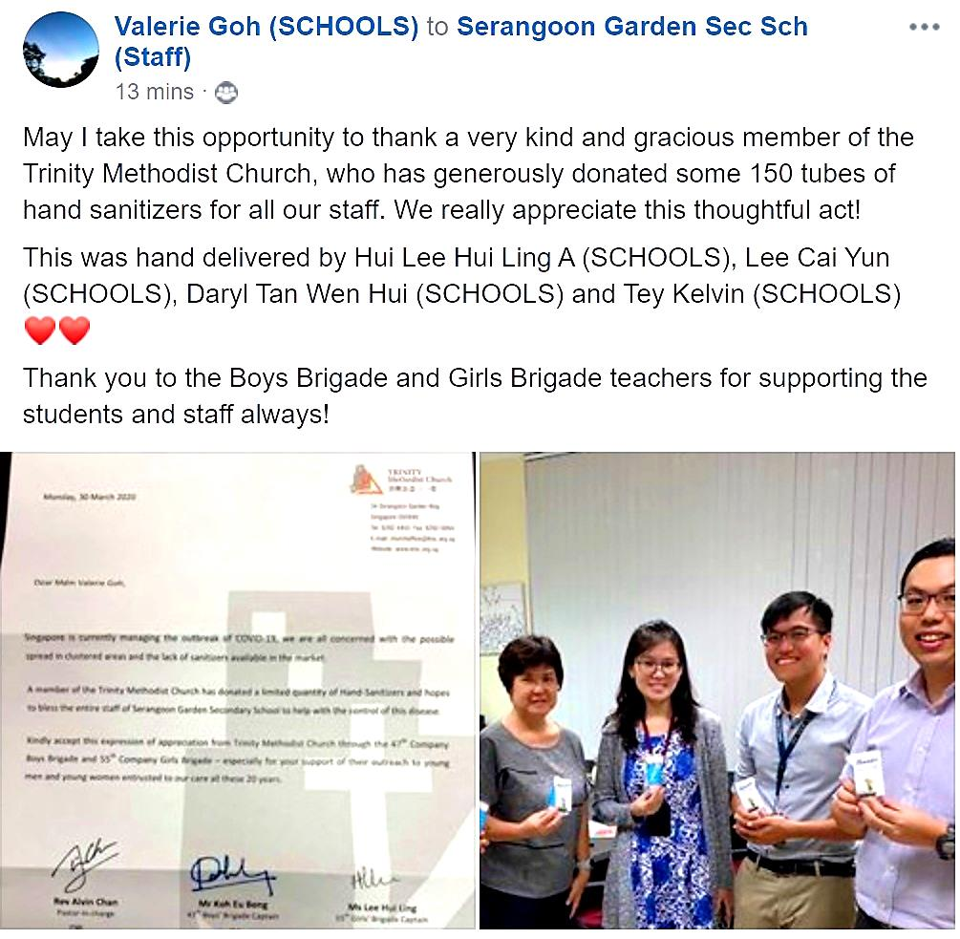
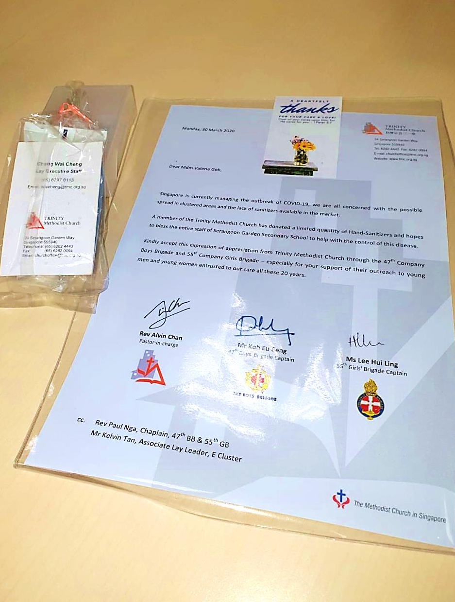
Project 2020: Sanitizers

Slide 28
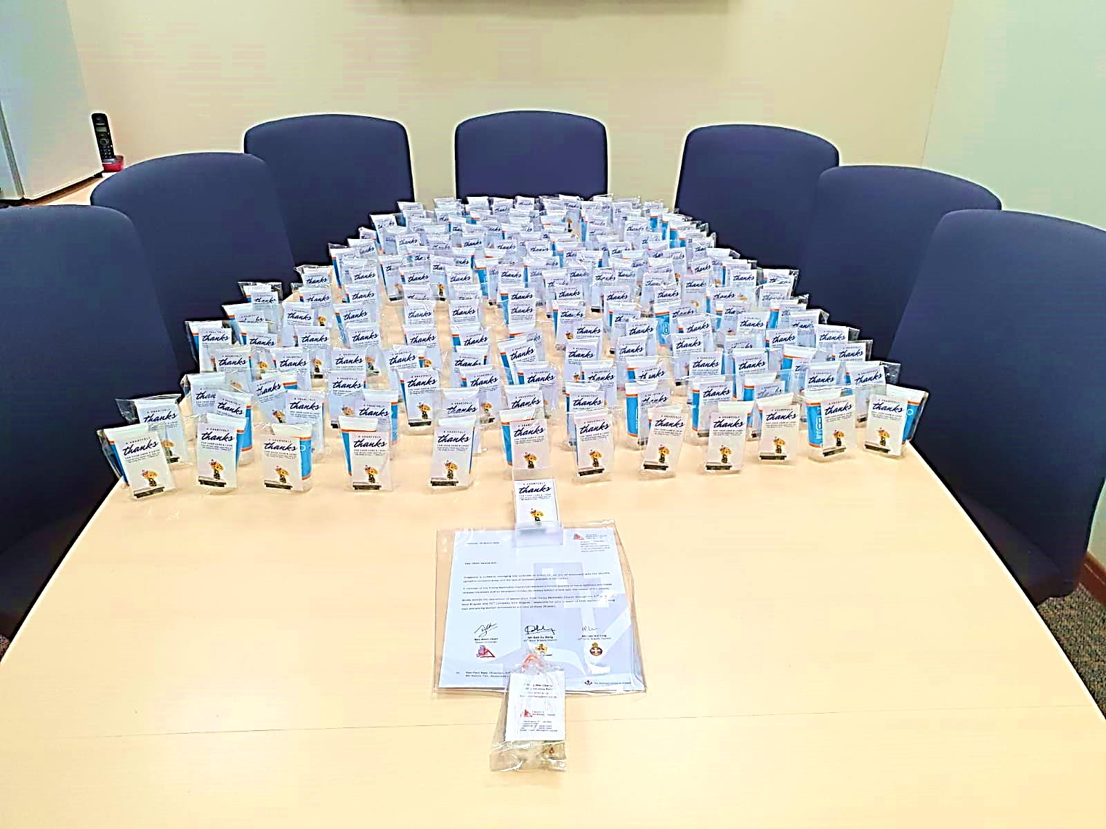
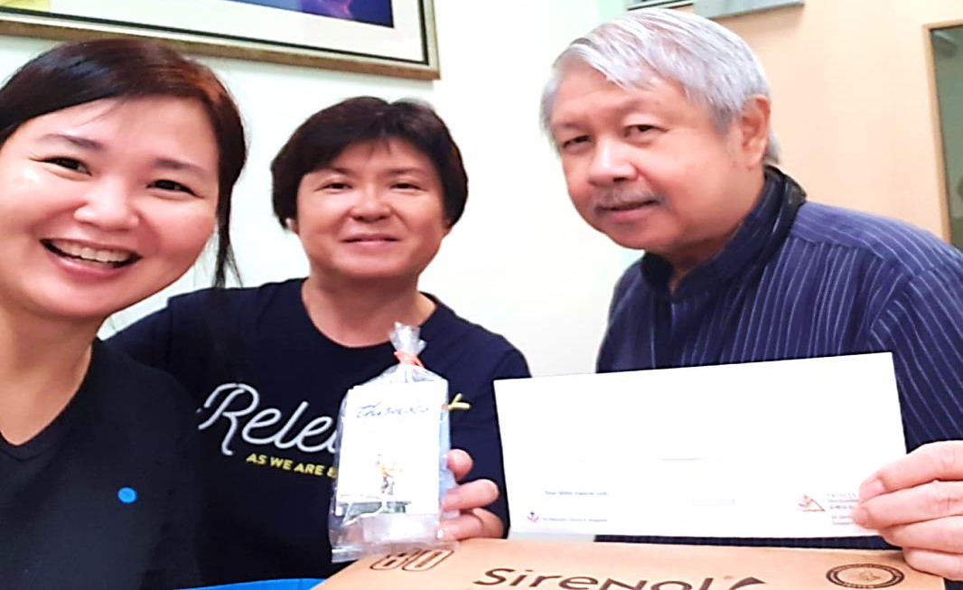
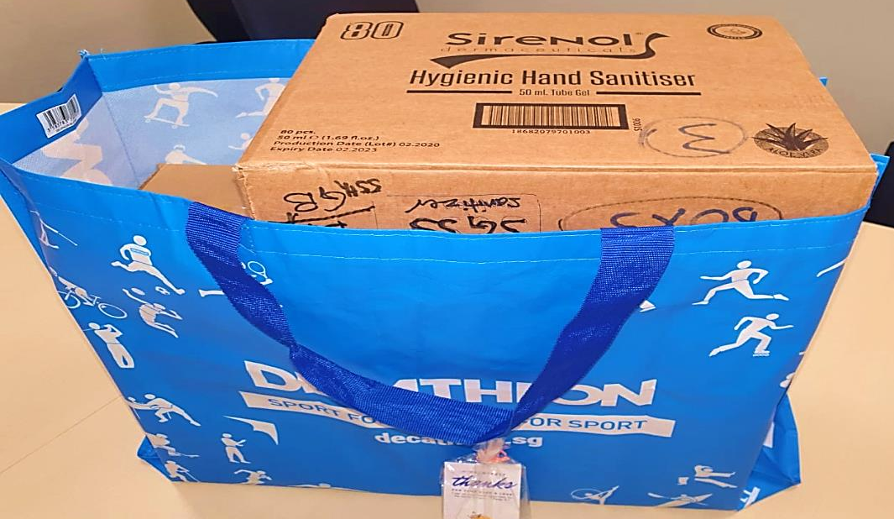

Slide 29
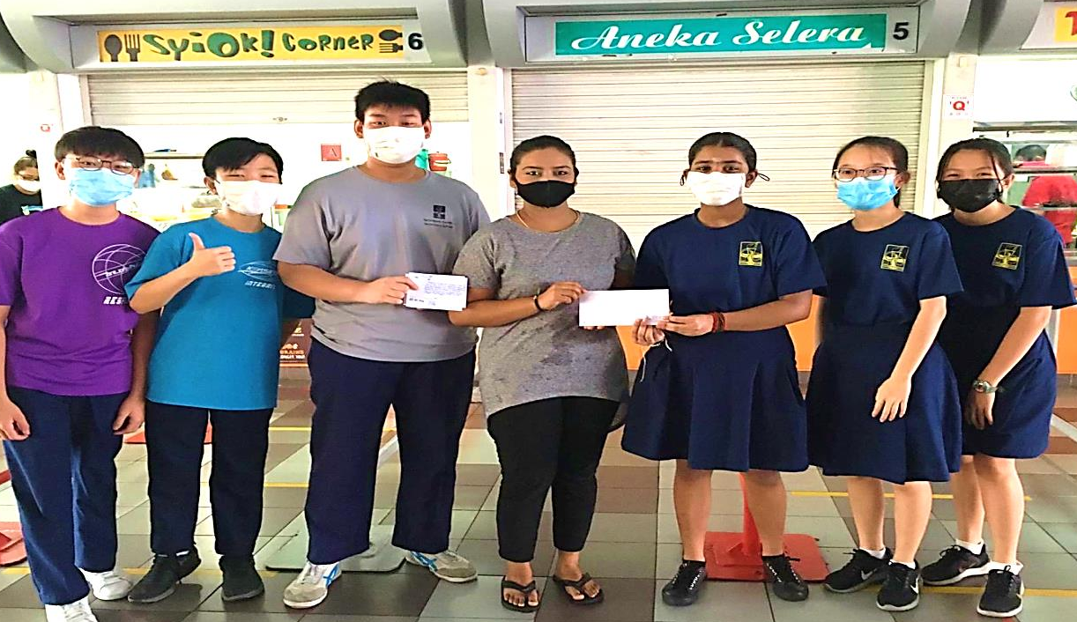
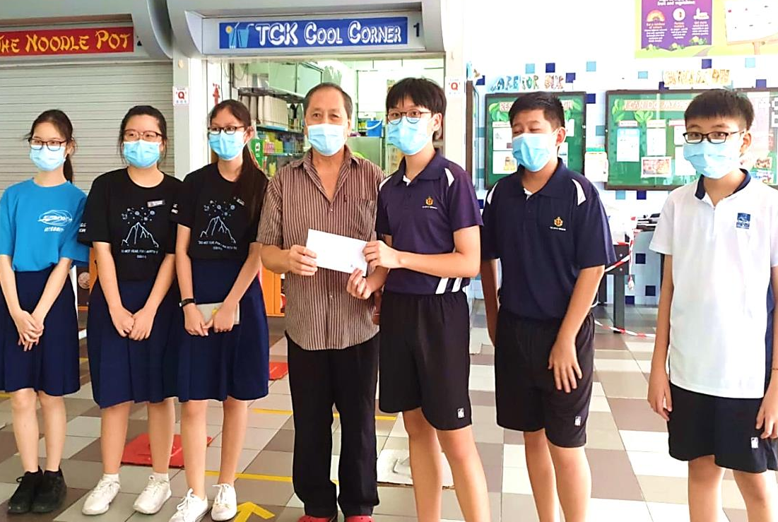
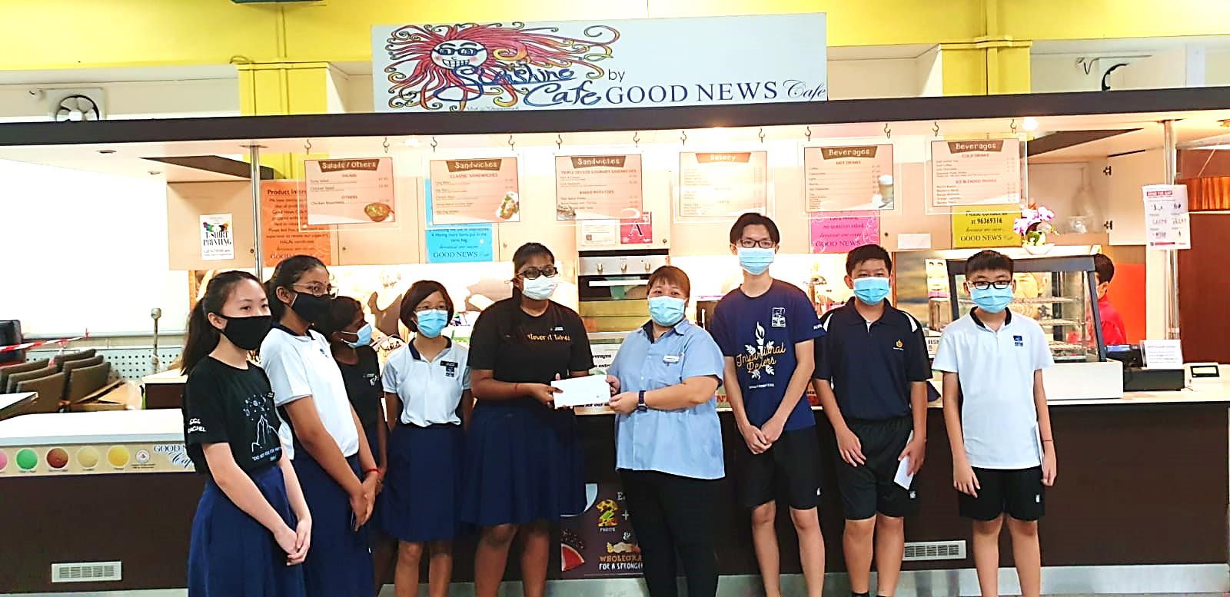
Project 2020: blessing canteen operators

Slide 30
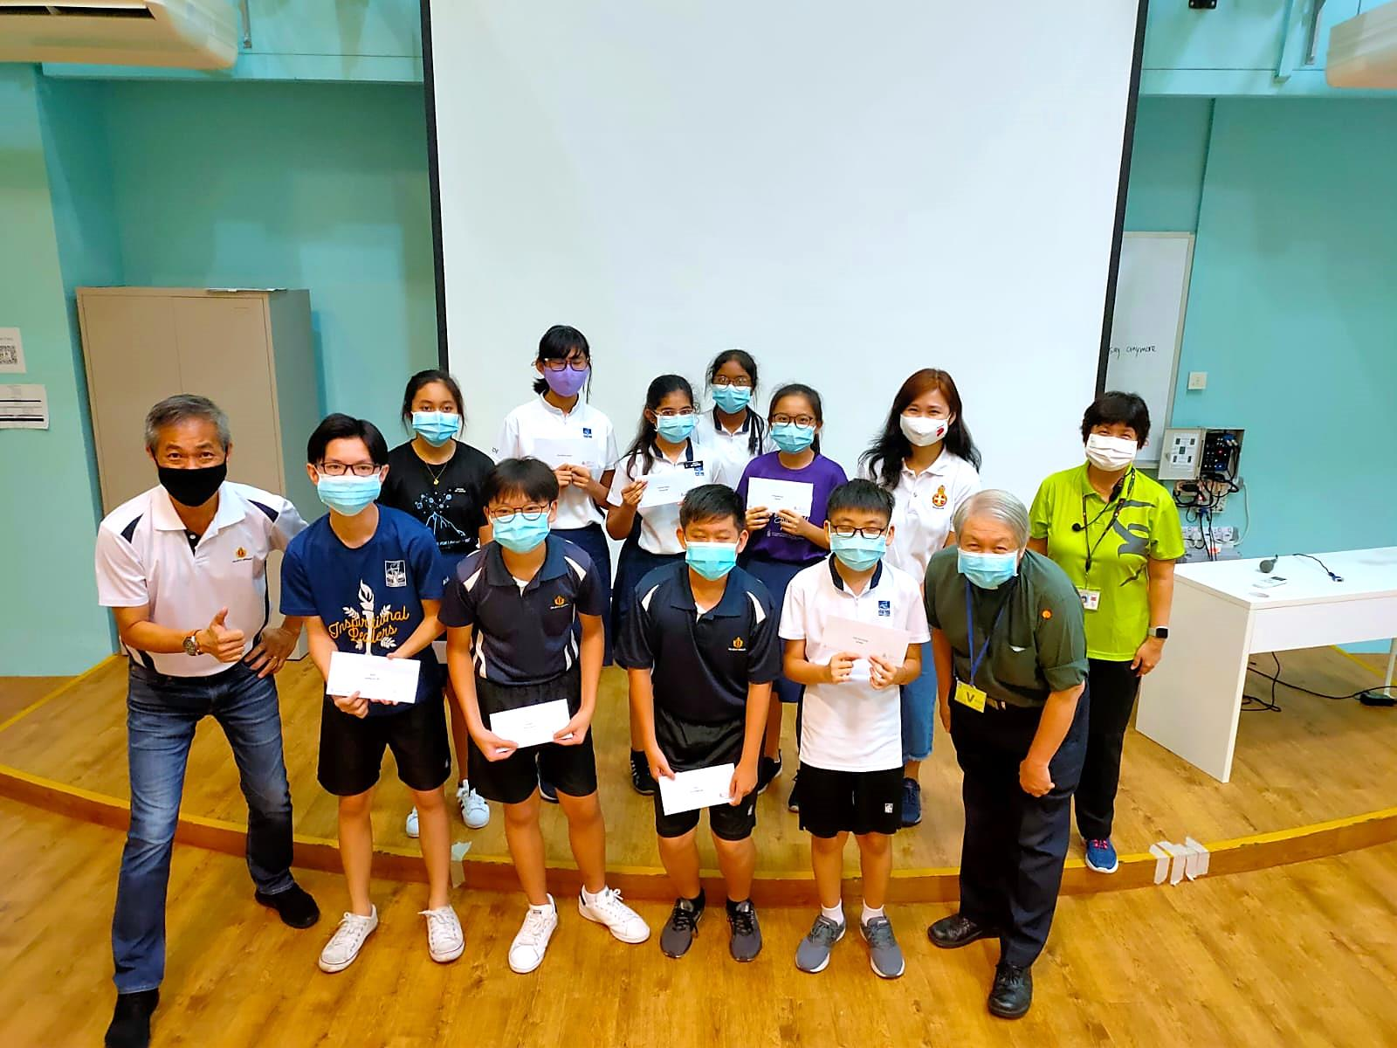
Scholarship 2020

